Slide 1
Weekly report: Machine Bed & Yaw System
Week No - 8
Date: 18.11.2025
Supervisor: Prof. Peter Quell
Shoukat Abbas, Luksh Chawla, Sathishkumar Venkatachalam, Shrihari G Kadam
Presented by – Shoukat Abbas

Slide 2
Contents
Yaw Bearing Finalized Dimensions
Yaw Bearing CAD Model
Yaw brake disc and brake callipers
Initial CAD design assumptions (Casted part)
References
Shoukat Abbas

Slide 3
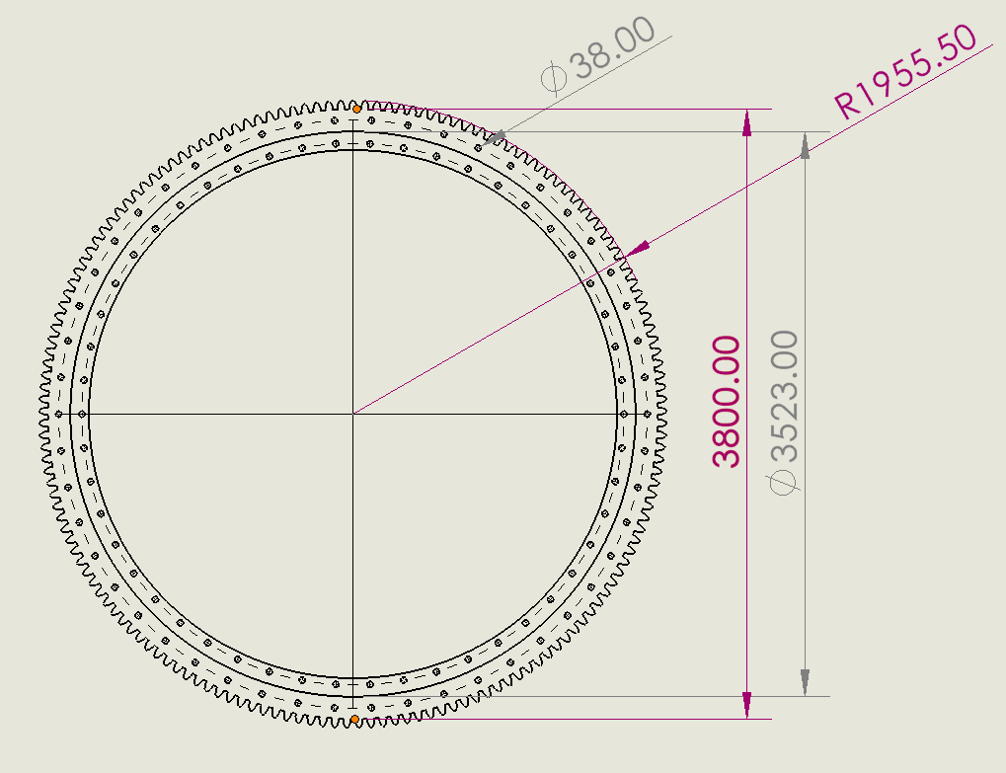
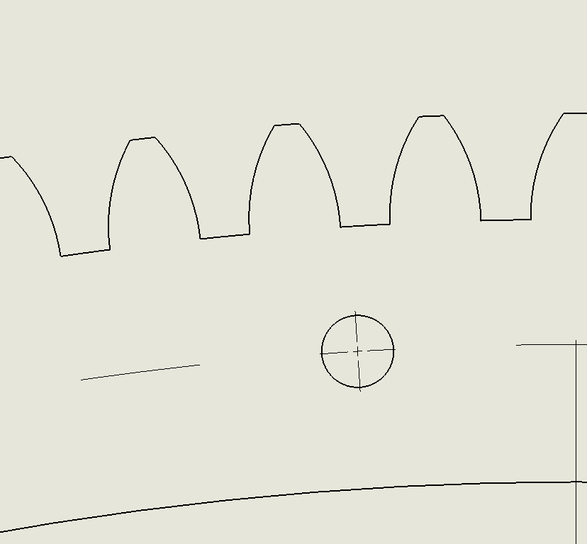
Yaw Bearing Final Dimensions
Double-row four-point bearing with External Gears
2D drawing from own 3D part
Teeth Profile
Shoukat Abbas

Slide 4
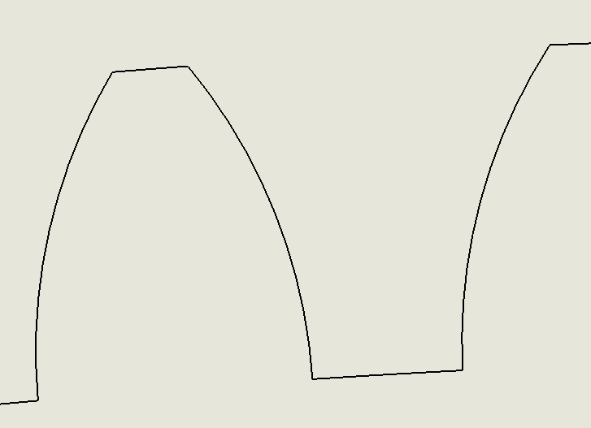
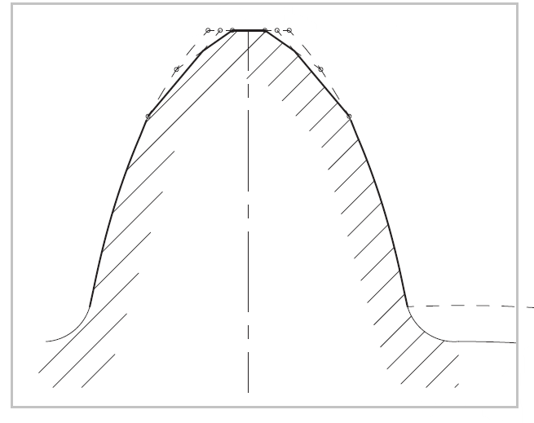
Yaw Bearing Tooth Profile
Pressure angle = 20°
Module m = 24
Tooth profile bearing
Tooth profile pinion
Shoukat Abbas

Slide 5
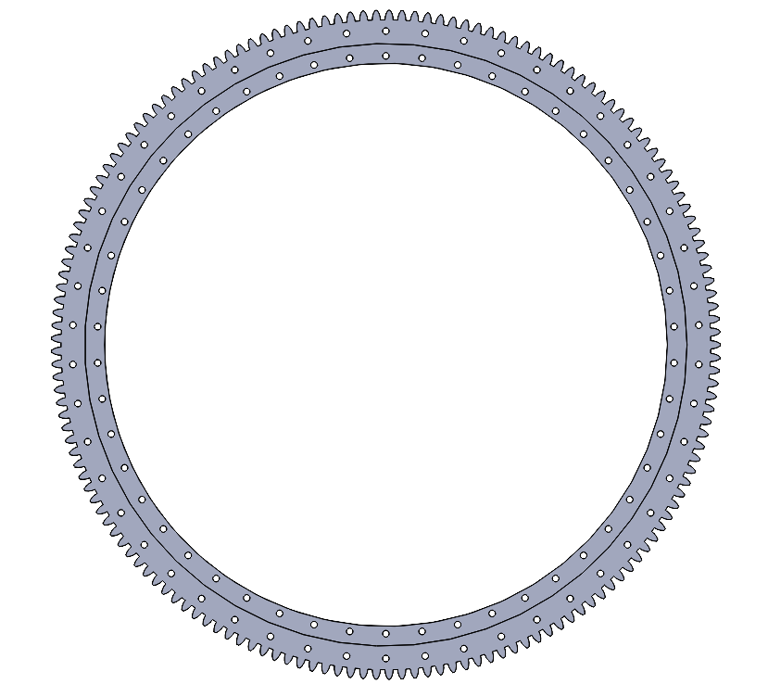
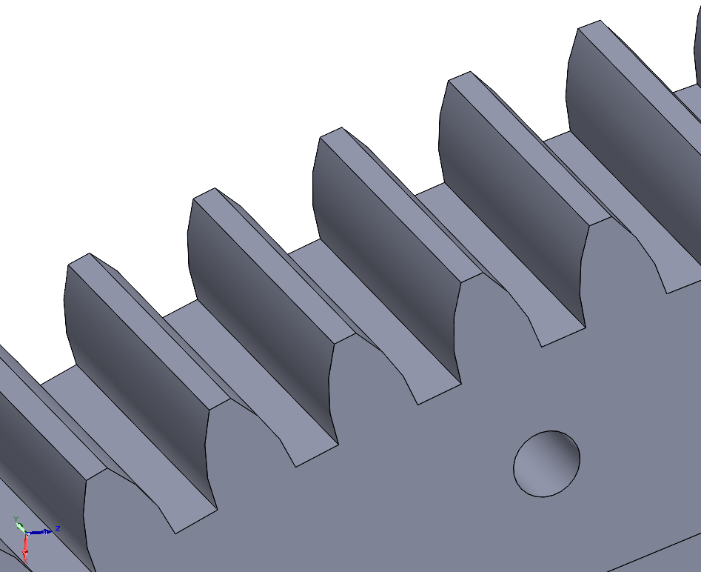
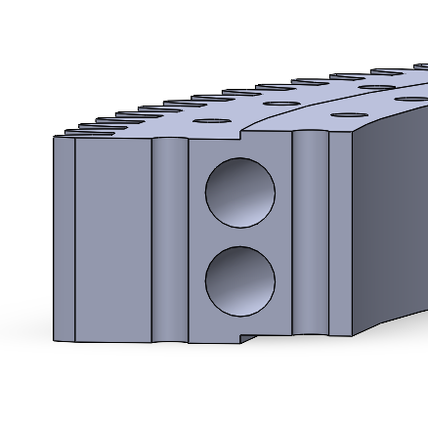
Yaw Bearing 3D Model
Top view
Tooth profile close-up
Cross-sectioned view
Shoukat Abbas

Slide 6
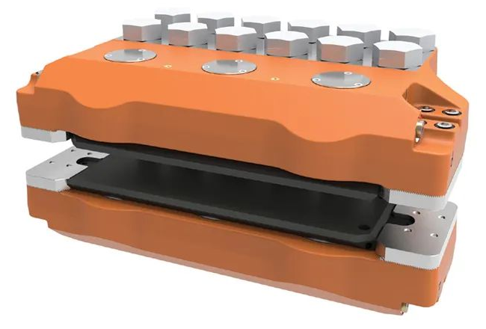
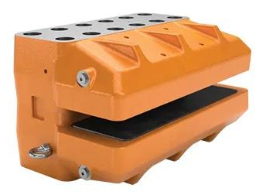
Brake Calipers selection and calculation
Our recommendations are the BSAC 120 or BSAB 120 brake from Svendborg Company. I have already contacted the company for one week, hoping to get their reply this week.
Svendborg BSAC120
Svendborg BSAB120
We have done the calculations of brake calipers, we are waiting for a reply from the manufacturer. We will present in next week. Including the parameters and calculation, no. of brake calipers for Optimus Syria are more or less 15.
Source: Svendborg-brakes/hydraulic-brakes
[1], [2]
Shoukat Abbas

Slide 7
Yaw Brake Disc and Brake Calipers
Yaw brake Svendborg BSAC120 - Specification
Brake Pad:
Pad width: 138 mm
Pad area (organic): 58,500 mm²
Maximum pad wear (organic): 7 mm (pad thickness = 14 mm)
Nominal friction coefficient: µ = 0.4
Hydraulic Characteristics:
Total piston area (each caliper): 678.6 cm²
Hydraulic Volume:
Volume per caliper at 1 mm stroke: 67.8 cm³
Volume per caliper at 3 mm stroke: 203.5 cm³
Operating Pressure:
Maximum operating pressure: 20.5 MPa
Minimum operating pressure: 9.0 MPa
Operating Conditions
General temperature range: –20°C to +70°C
Wind turbine temperature range: –40°C to +60°C
[1], [2]
Shoukat Abbas

Slide 8
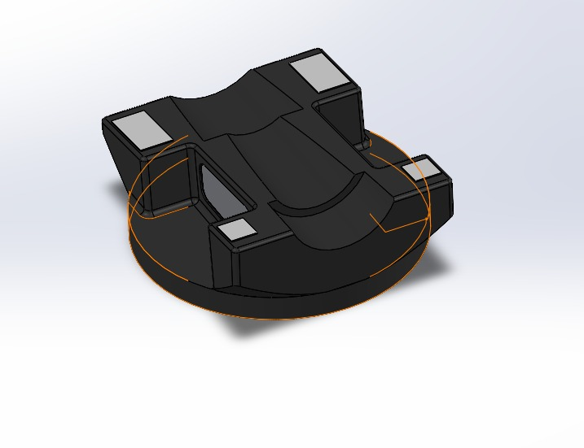
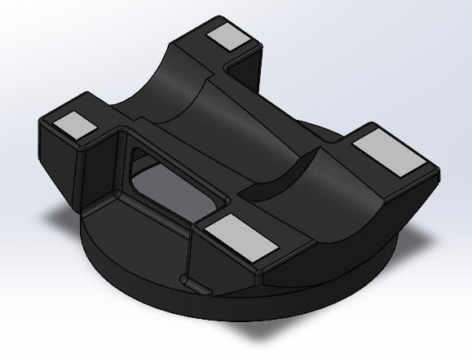
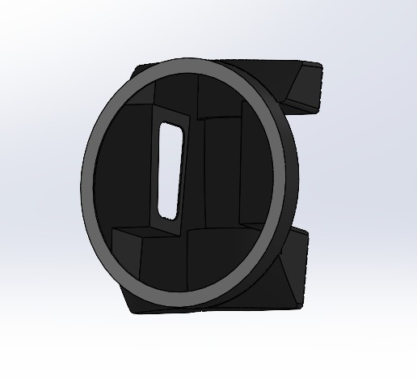
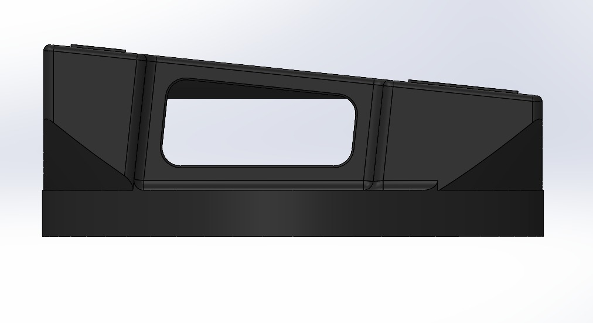
Bed Casting – Start modelling (Initial phase)
We have started CAD modelling of the bed (casted part). We will modify according to requirements.
Placement of yaw drives is a bit technical, but we’re working on it and will come to an outcome as soon as possible.
Shoukat Abbas

Slide 9
References
    [1]. Hydraulic brakes Svensborg brakes, https://www.svendborg-brakes.com/products/hydraulic-brakes/active-brakes/bsac-120/ (accessed: 13.11.2025)
    [2]. Hydraulic brakes Svensborg brakes, Svendborg-brakes /product-catalogue/ (accessed: 13.11.2025)
Shoukat Abbas

